Slide 1
supporting the
Electronic Manufacturing Services market
CONFIDENTIAL: All contents copyright of Illinois Tool Works, Inc. (ITW).
The ITW Photonics Group, Cal Sensors, ITW Linx, Lumex and Opto Diode logos are registered trademarks of ITW, Inc. Copyright © 2013, all rights reserved.

Slide 2
Supporting the Electronic Manufacturing Services Market
As one of the most recognized brands in the market, Lumex has been renowned as a world leader in optoelectronics. Lumex has a rich history of outstanding customer service, dedication to technical expertise and an extensive and ever-growing line of opto products.
For over 30 years, Lumex has been supporting EMS firms in providing their customers with competitive, cutting-edge, top-quality products for the market. Lumex is regularly evaluated as a top supplier, and EMS designers and manufacturers have come to count on Lumex for their documented ability to:
    Provide high-level technical engineering support, while maintaining strict standards of confidentiality
    Provide high-quality, state-of-the-art products
    Streamline manufacturing to assist with assembly processes
    Shorten lead times
    Provide consistent, on-time delivery
    Ensure low failure rates on product testing
Lumex Product Families
High Power LEDs
Ultraviolet LEDs
Thru-Hole & SMD LEDs
Panel & PCB Indicators
LED Displays
LED Arrays
Light Pipes
Infrared Devices
Monochromatic & Color LCDs
CONFIDENTIAL: All contents copyright of Illinois Tool Works, Inc. (ITW).
The ITW Photonics Group, Cal Sensors, ITW Linx, Lumex and Opto Diode logos are registered trademarks of ITW, Inc. Copyright © 2013, all rights reserved.

Slide 3
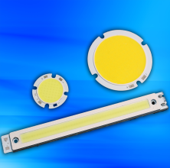
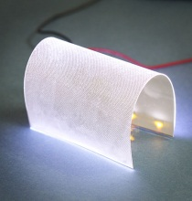
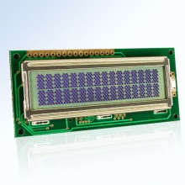
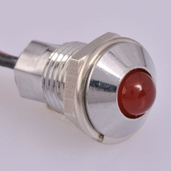
Innovative Product Solutions
Wireless Bond LED Technology
No wire bond and a silicon layer provide enhanced shock and vibration resistance
Superior heat dissipation and light performance
Available in both standard and custom colors and shapes
Available in 3W wireless bond light bar modules and 6W wireless bond round modules in addition to custom colors (including blue) and sizes for 3W, 6W and 9W
Industry 1st, Shapeable, Flexible LED Backlight!
Unique backlight can be shaped (i.e., to allow space for a switch or other component on the circuit board) without causing shadowing or a compromising light performance
Profile height of just 0.125mm (97% thinner than traditional backlights)
Specially designed ultra-thin surface, specifically designed for enhanced light distribution
Extreme Temp Character & Graphic LCD Modules
Offering temperature ranges from -40˚C to +85˚C with consistent hot and cold start LCD performance
Provides high-resolution, high-duty daylight visibility
Available in either positive or negative image display
LED Panel Indicators
High brightness daylight visibility
Multi-color display capability
Industry-standard connectors
Operating temperature range from -40˚C to +85˚C
NEW! 120 Volt AC LED panel indicators, which eliminate the need for AC to DC power conversion
CONFIDENTIAL: All contents copyright of Illinois Tool Works, Inc. (ITW).
The ITW Photonics Group, Cal Sensors, ITW Linx, Lumex and Opto Diode logos are registered trademarks of ITW, Inc. Copyright © 2013, all rights reserved.

Slide 4
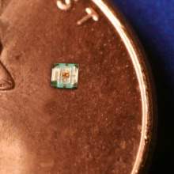
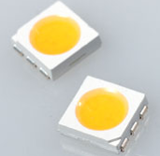
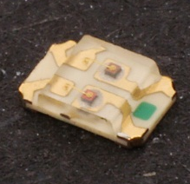
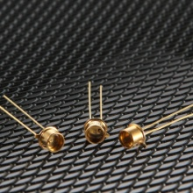
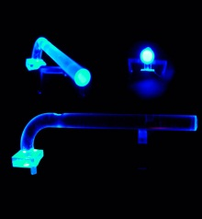
Innovative Product Solutions
0404 Surface-Mount RGB LEDs
Full color surface-mount RGB LED
0404 Packaging – 1.0mm x 1.00mm x 0.25mm
Low current operation (30/40/20 mcd respectively for RGB @ 2mA)
Operating temperature range from -40˚C to +85˚C
PLCC-6, 5050 Package
State-of-the-art high brightness chip technology
3 Dice per LED package
Lead frame / lens casting reliability
0805 Package, Bi-Color SMD LEDs
State-of-the-art high brightness chip technology
Custom solutions available
Easy-to-solder, Gold finish
Lens casting reliability
Choice of LED colors
Ultraviolet (UV) LEDs
Available in 355nm, 365nm, 377nm, 385nm 405nm and 415nm wavelengths with 4-6mW power output
Longer lifespan; greater than 50,000 hours
TO-46 package, with glass lens in a through-hole format
Custom wavelengths are available
Light Pipes (LPF series)
Ray Trace Software with Precise 3D CAD/CAM Models
Right angle and vertical standard packaging solutions
Accommodates all colors
Custom solutions accommodating varying height & widths available with minimal tooling
CONFIDENTIAL: All contents copyright of Illinois Tool Works, Inc. (ITW).
The ITW Photonics Group, Cal Sensors, ITW Linx, Lumex and Opto Diode logos are registered trademarks of ITW, Inc. Copyright © 2013, all rights reserved.

Slide 5
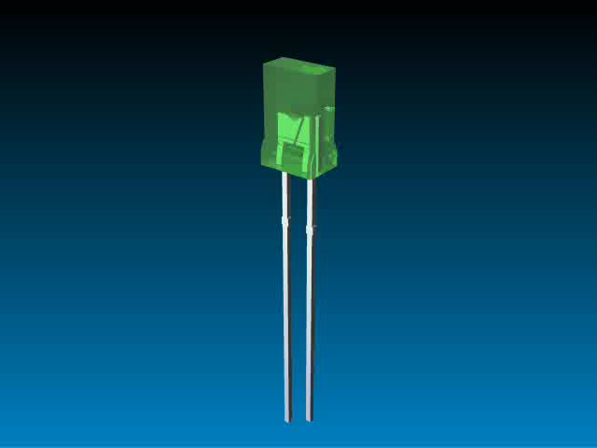
Multiple Technologies…
One Product Solution
In today’s competitive marketplace, many engineers are finding that many standard technologies do not meet all of their needs.
More and more, design engineers are recognizing that an application-specific solution will offer the best result for more complex design needs.
Lumex has proven success at translating initial design concepts and turning them into reality.
Whether addressing a current
design challenge or integrating
multiple components into one
sub-assembly, Lumex will work
with you from initial prototype
through final production.
Together, Digi-Key
and Lumex offer experience,
quality and innovative originality
to help bring products to market
faster and help provide that
competitive edge.
Benefits of
Value Add Solutions
Focus on application needs
Stand out from competition
Enhanced reliability
Speed time to market
Reduced labor costs
Faster ROI
Full plug ‘n play solution
Engineering know-how that acts as an extension of your own team
CONFIDENTIAL: All contents copyright of Illinois Tool Works, Inc. (ITW).
The ITW Photonics Group, Cal Sensors, ITW Linx, Lumex and Opto Diode logos are registered trademarks of ITW, Inc. Copyright © 2013, all rights reserved.

